Slide 1

Report on
Global Trade Analysis Project
(Using Tableau)
Domain – International Trade
Project ID : CP2
Name: Shreya Chandekar
Submitted on: 31/12/2018

Slide 2
1. Project Brief
An Indian manufracturing company wants to launch a new business unit, focusing on the globle trade and logistics, majorly in the countries such as USA, CANADA and AUSTRALIA.
They have collected import and export data of 12 major commodities including the commodity name, year(1988 – 2017), Trade amount in USD, quantity.
The datasets contain 59090 Observation with 10 Variables.

Slide 3
2. Objective of the Study
The company wants an innovative and interactive tableau dashboards and the important insights that focus on potential commodities, trade amount, year, quantity of that commodities and the countries.
They also want the commodities data to be cleaned using R for better visualization

Slide 4
3. Data Description
Variable | Description
Country_or_Area | There are the three different countries – Australia, Cananda and USA
Year | Year from 1988 to 2016
Commodity_Code | Each Commodity have different code
Commodity | Various trade commodities which comes under different categories
Flow | The flow of trade – Export, Import, Re-Export, Re-Import
Trade_USD | Trade amount in Dollars
Weight_kg | Weight of the Commodites in kg
Quantity_Name | Quantity name of the Commodities
Quantity | Quantities of the Commodities that are traded
Category | There are the 12 unique Categories.

Slide 5
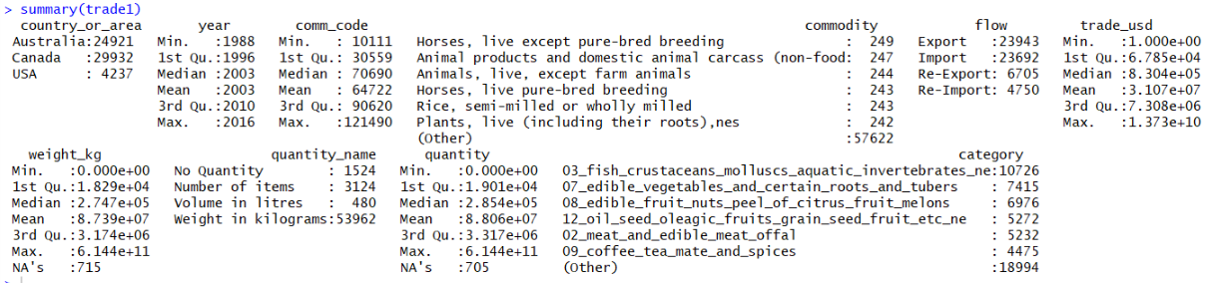
4. Data Exploration
By exploring the data, it was found out that there are 2 variables in the data set
which contains the missing values. The variables are Weight and Quantity
These variable may contain 0 or NA. In variables Quantity name have No Quantity
values which show it contain 0 or NA values. We need to analyse it and make it
more effective.

Slide 6
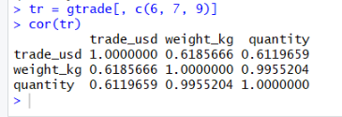
Correlation between numerical variables such as Trade Amount, Weight and Quantity
From this correlation, we found out that there is high correlation between the variable
Weight and Quantity.
Trade amount is in correlation between the Weight and Quantity.
So this means that the Weight and the Quantity is important for the Trade amount.
Investigating the missing information by assigning the 1 to the Weight and Quantity
when it is 0’s and NA’s.

Slide 7
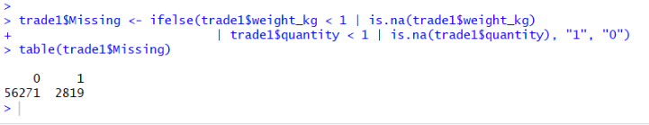
This shows that there are 2819 observations are missing.
On analysing this missing values, assessed its impact on the each country and its flow of trade.
We get,
Australia - $13.5 Billions of loss
Canada - $32.5 Billions of loss
USA - $36.9 Billions of loss
So much billions of dollars of loss cant be ignored. This should be investigated.

Slide 8
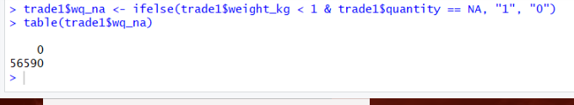
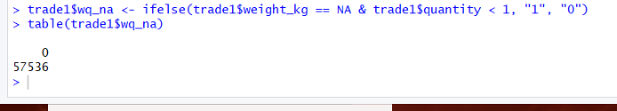
5. Data Cleaning
By analysis each of the variable that has missing values, to check if there is any relation between the missing values of weight and quantity.
We get 56590 observation says “0 “ which means that show there is no relations between them.
In another, we get 57536 observation says “0” which means that there is no relations between them.
So, removed the missing values from that variables.

Slide 9
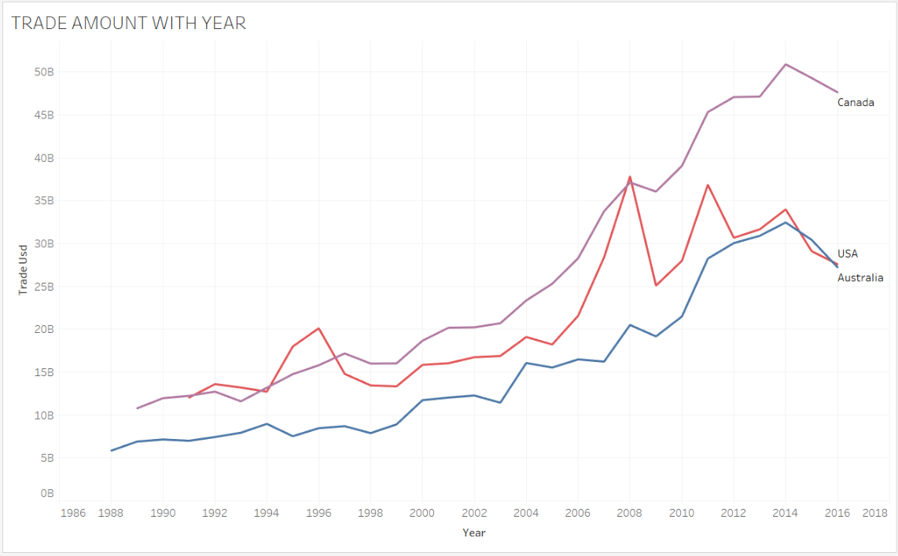
6. Data Visualization
Canada has trade higher than USA and Australia.

Slide 10
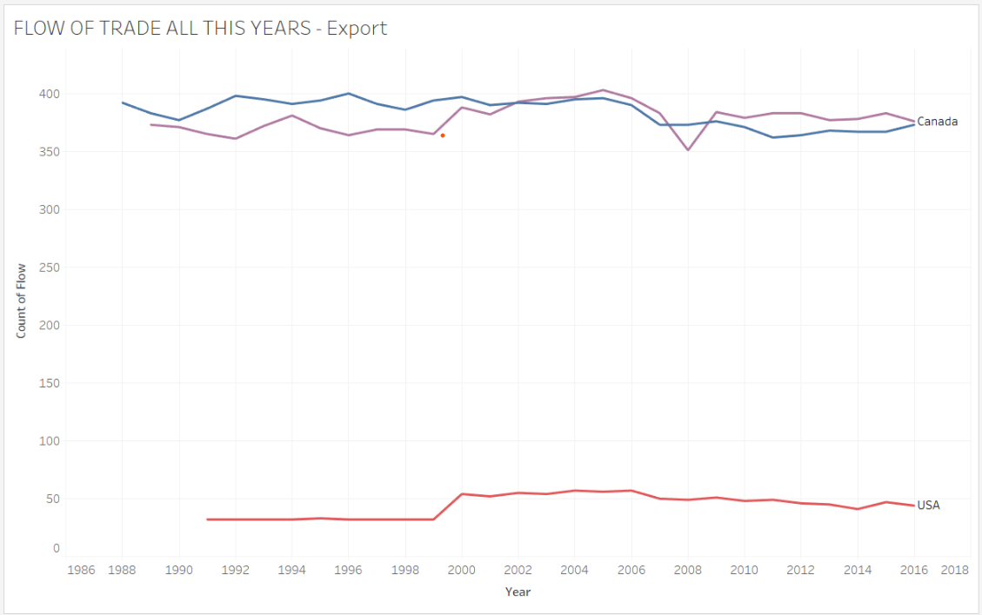
From this graph this shows that Australia starts exports its trade from 1988 while Canada starts its trade in 1989 and USA starts exports its trade in 1991.

Slide 11
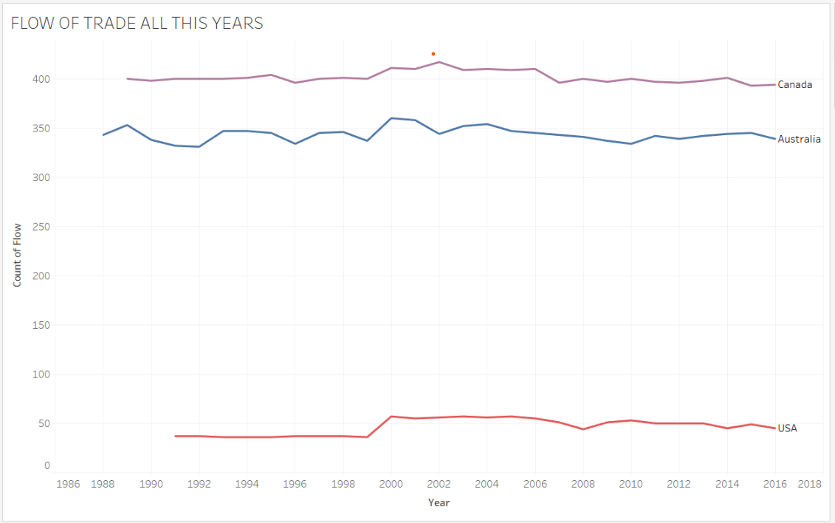
From this graph this shows that Australia starts import its trade from 1988 while Canada starts its trade in 1989 and USA starts import its trade in 1991.

Slide 12
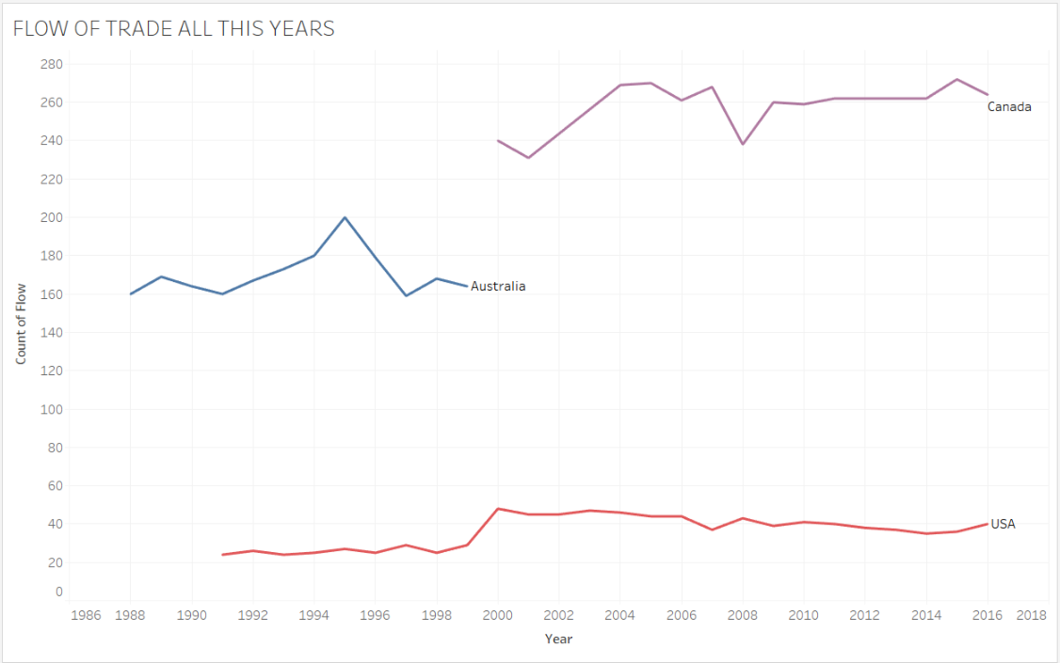
Australia is Re-exporting its trade from 1988 to 1999. from then Australia didn’t Re-export any of its trade.
USA start it’s Re-exporting in 1991 and continue to Re-export till 2016. and Canada starts its Re-export from 2000 till 2016.

Slide 13
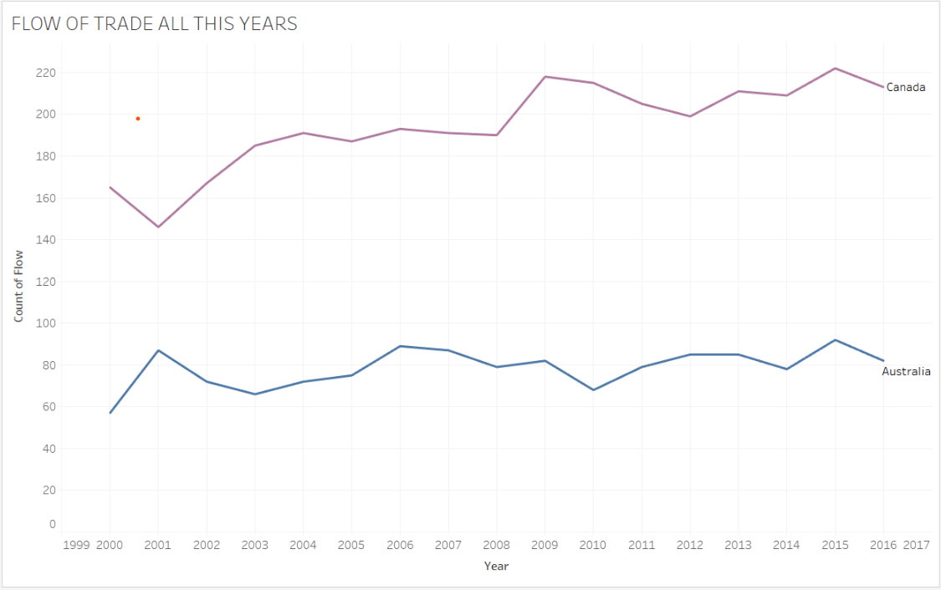
Australia and Canada starts its Re-importing Trades from 2000 and continue till 2016. But USA never Re-import any of its trade all this years.

Slide 14
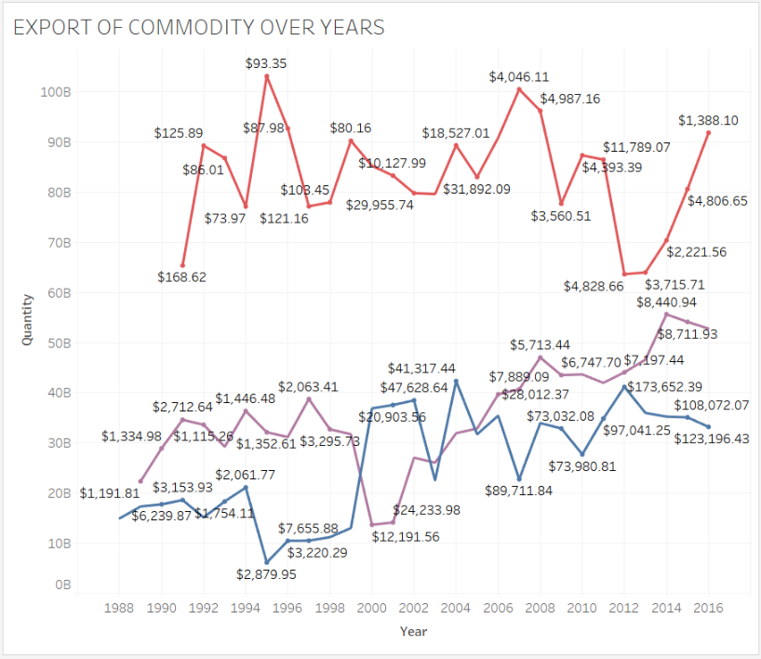
Export of the commodities for all the countries over all these years are increasing
time to time.

Slide 15
Calculating Trade Balance
Trade Balance calculate the country’s net worth on earned on the international assets.
Trade Balance = Total Export Values – Total Import Values
When the Trade Balance is positive, then it is called the Trade Surplus
When the Trade Balance is negative, then it is called the Trade Deficit.
By looking the data of Export and Import of the country’s from 1988 to 2016, then Trade Balance has been positive which shows that Trade Surplus. Which means the Export of the country’s trade is more than that of the Import trade.
Which means that all country’s in profit till now.
Australia Earned highest profit of $319.48B and then USA earned profit of $295.83B. Canada make low profit of $238.73B among all three countries.

Slide 16
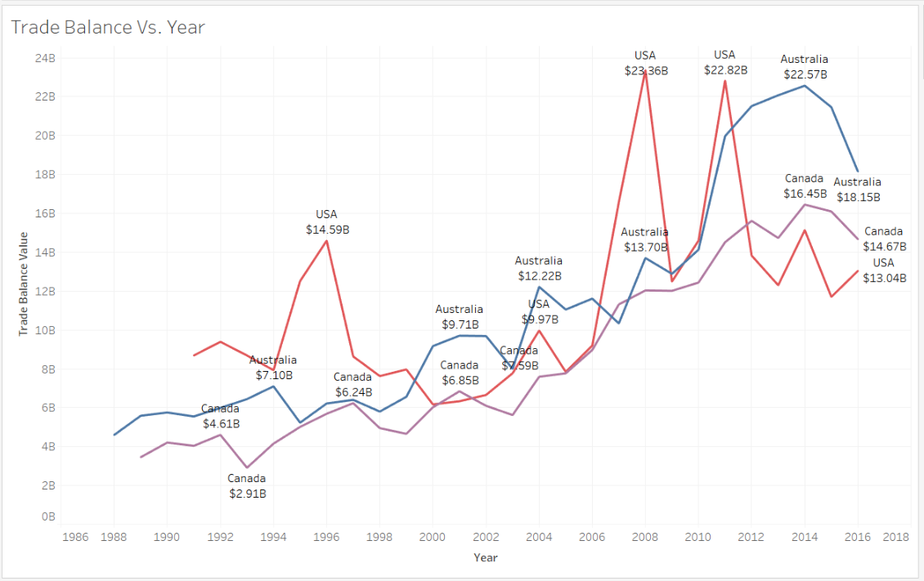
From this graph, Australia gain the profit in year 2014 from this trades.
USA gain highest profit in year 2008. For Canada, it Trade Balance increase time to time.

Slide 17
7. Insights Derived
Canada is the highest in Export, Import, Re-Export and Re-Import in all of its commodities over trade.
USA has never Re-imported commodities throughout these years.
Australia hasn’t Re-exported commodities since the year 2000.
Canada started its Re-exporting commodities from year 2000.
By calculating the Trade Balance, it observed that all the countries had Trade Surplus from 1988 to 2016. Australia make highest profit among all three.
After identifying the potential commodities, then observe its quantity and the unit price over the past years, it was observed that unit prices are different for the different country.

Slide 18
All the Dashboards are in linked below:
https://public.tableau.com/profile/shreya5847#!/vizhome/CommodityVs_Country/GLOBALTRADECOUNTRYWISE

Slide 19
THANK YOU

